Slide 1



Digital Electronics

Slide 2


CHAPTER-2
Minimization Techniques

Slide 3
Boolean Algebra
Boolean Algebra: In 1854 Logical algebra was published by George Boole known today as “Boolean Algebra”.
It’s a convenient way and systematic way of expressing and analyzing the operation of logic circuits.
1938: Claude Shannon was the first to apply Boole’s work to the analysis and design of logic circuits.
Boolean Operations & Expressions:
Variable: A symbol used to represent a logical quantity.
Complement: The inverse of a variable and is indicated by a bar over the variable.
Literal: A variable or the complement of a variable.

Slide 4
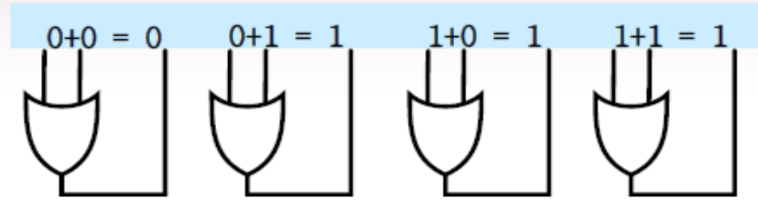
Boolean Algebra
Boolean Algebra Boolean Addition:
Boolean addition is equivalent to the OR operation.
A sum term is equal to 1 when one or more of the literals in the term are 1.
A sum term is equal to 0 only if each of the literals is 0.

Slide 5
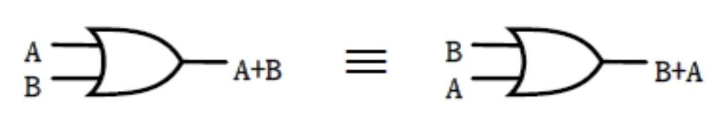

Laws & Rules of Boolean Algebra
Commutative Laws: The commutative law of addition for two variables is written as:
A+B = B+A.
The commutative law of multiplication for two variables is written as: AB = BA.

Slide 6
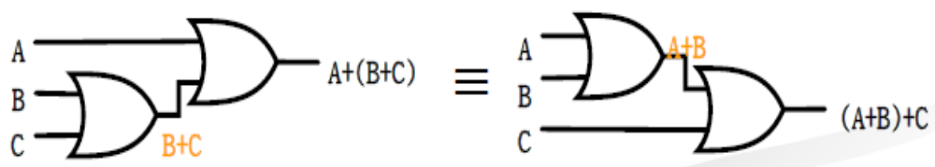
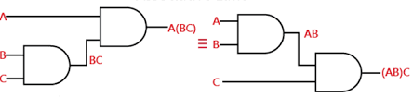
Laws & Rules of Boolean Algebra
Associative Laws: The associative law of addition for 3 variables is written as:
A+(B+C) = (A+B)+C
The associative law of multiplication for 3 variables is written as: A(BC) = (AB)C

Slide 7
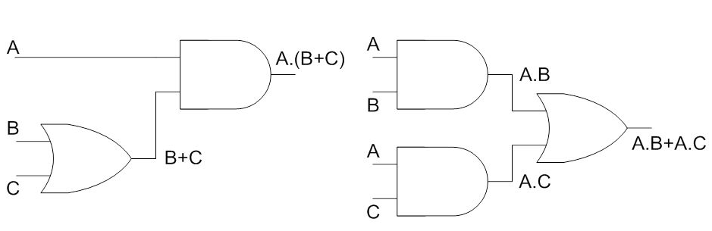
Laws & Rules of Boolean Algebra
Distributive Laws:
The distributive law is written for 3 variables as follows: A(B+C) = AB + AC

Slide 8
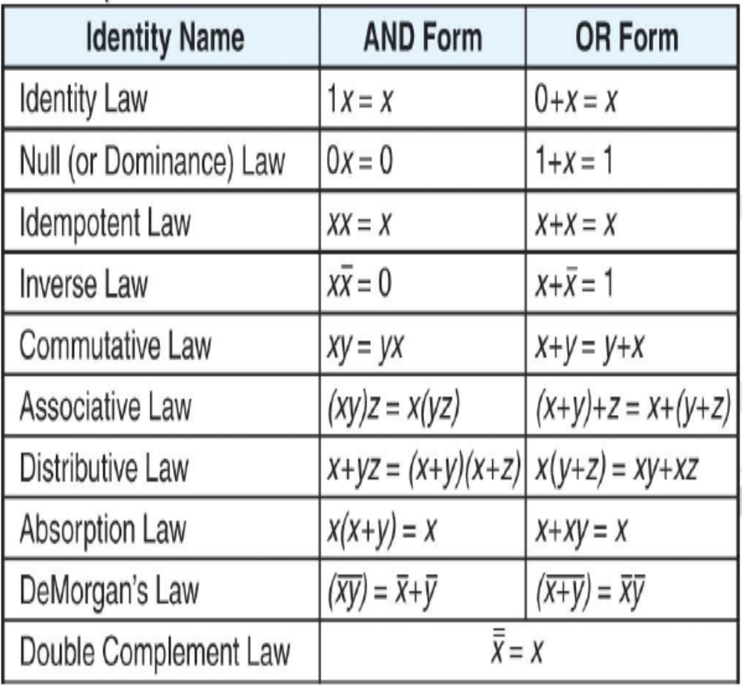
Basic Boolean Identities
As with algebra, there will be Boolean operations that we will want to simplify We apply the following Boolean identities to help.

Slide 9
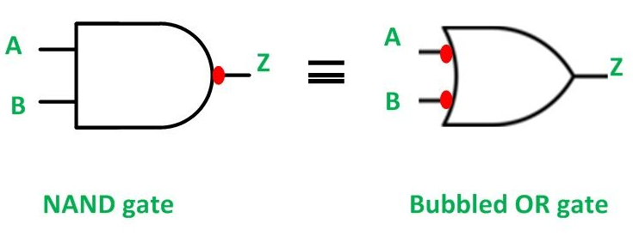
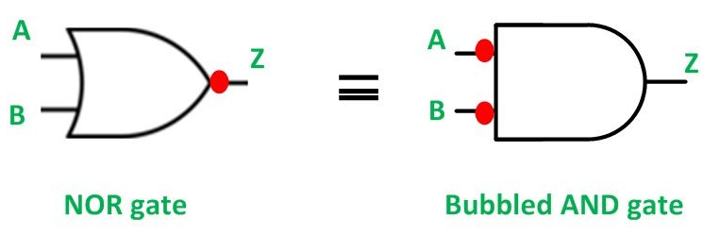
DeMorgan’s Theorems
DeMorgan’s theorems provide mathematical verification of:
  The equivalency of the NAND and negative-OR gates.
The complement of two or more ANDed variables is equivalent to the OR of the complements of the individual variables.
  The equivalency of the NOR and negative-AND gates.
The complement of two or more ORed variables is equivalent to the AND of the complements of the individual variables.

Slide 10
Duality Theorem
It states that if you have true Boolean equation then the dual of this statement is true.
The dual of a boolean statement is found by replacing the statement’s symbols with their counterparts. This means a “0” becomes a “1”, “1” becomes a “0”, “+” becomes a “.” and “.” becomes a “+”.
Given Expression | Dual
0 = 1 | 1 = 0
0.1 = 0 | 1 + 0 = 1
A.0 = 0 | A + 1 = 1
A.A = 0 | A + A = 1
A.(B.C) = (A.B).C | A+(B+C) = (A+B) + C

Slide 11
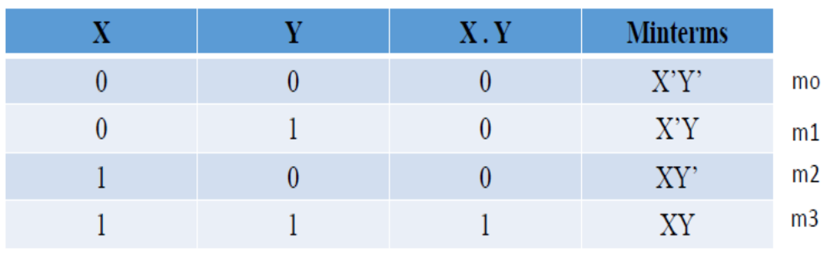
Min-term
If a boolean function contains n variables than a product term which contains all the variables once in either complemented or uncomplemented form is called minterm.
In the minterm main property of each minterm is that it will have value one only.
For n variable expression the no. of minterms are 2n like- if n=2 than minterms are 4, n=3 than minterms are 8.
All the minterms are can be represented by m0, m1, m2………..
Example:

Slide 12
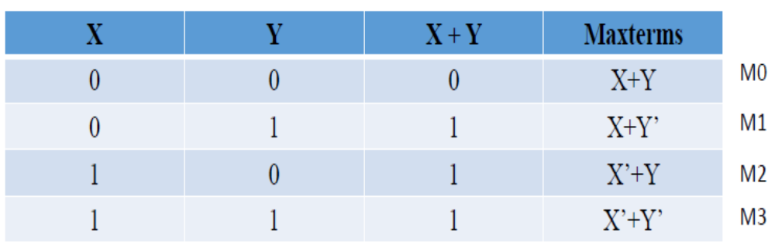
Max-term
If a Boolean function contains n variables and the sum term contains all the possible combinations of n variables than the sum term is known as maxterm.
This term is opposite of minterm because the value of each maxterm is 0. The maxterm can be represented as M0, M1,………..
The main property of each maxterm is that it has value 0 only for one combination of n input variables.
Example:

Slide 13
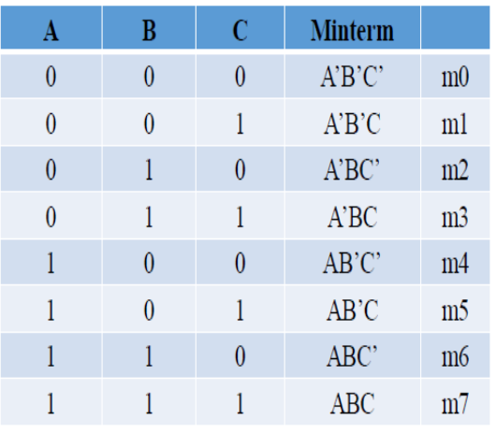
Sum of Products (SOP)
When we perform the sum of logically multiplied inputs than the resultant expression is called sum of product. The canonical or standard SOP is the sum of minterms.
Product of Sums (POS):The product of sum can be defined as the logical product of the maxterm for which it has the value 0.

Slide 14
Karnough Map (K- map)
Some times the Boolean theorems and laws makes the simplification logics of Boolean functions more complex. Than we have to use the k-map techniques.
It is a graphical method which is used to simplify a Boolean function or to convert a truth table into its equivalent logic circuit.
The k-map is designed by squares where each square represents a minterm or maxterm.
We will determine these techniques by studying examples in order to establish the rules for map manipulation.

Slide 15
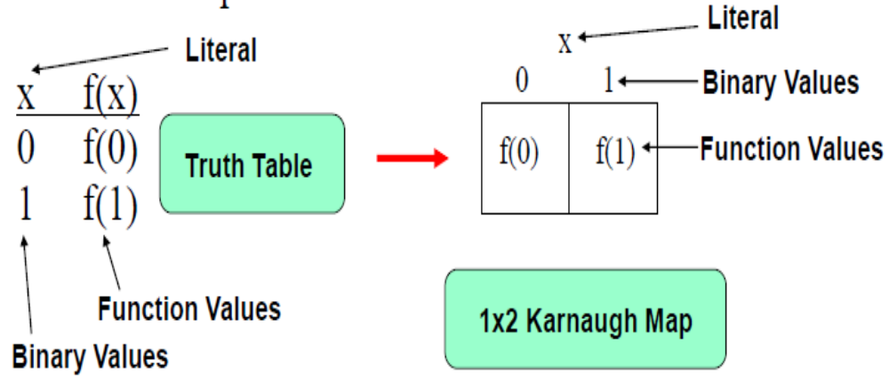
1- Variable K- Map

Slide 16
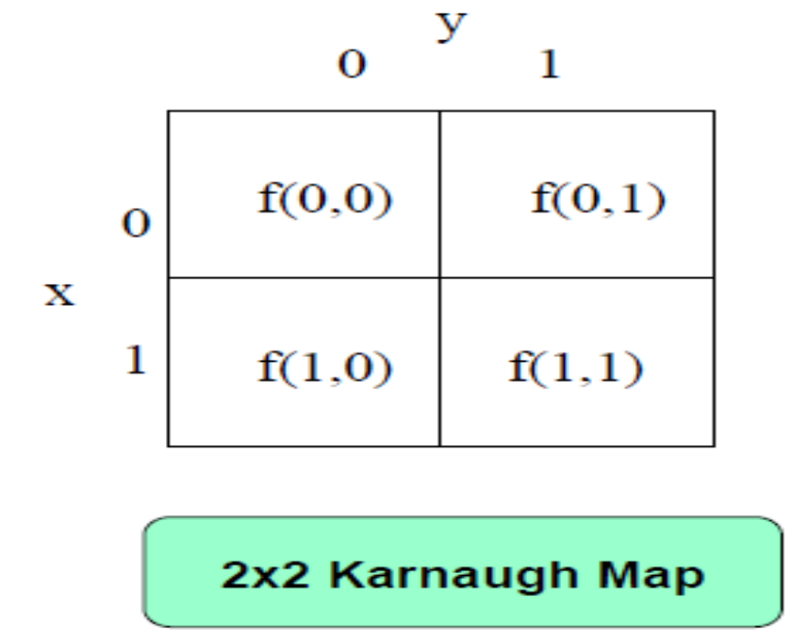
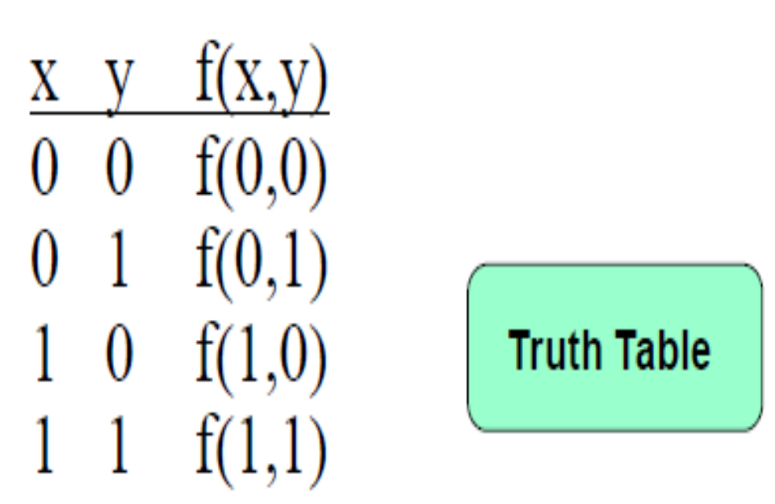
2- Variable K- Map

Slide 17
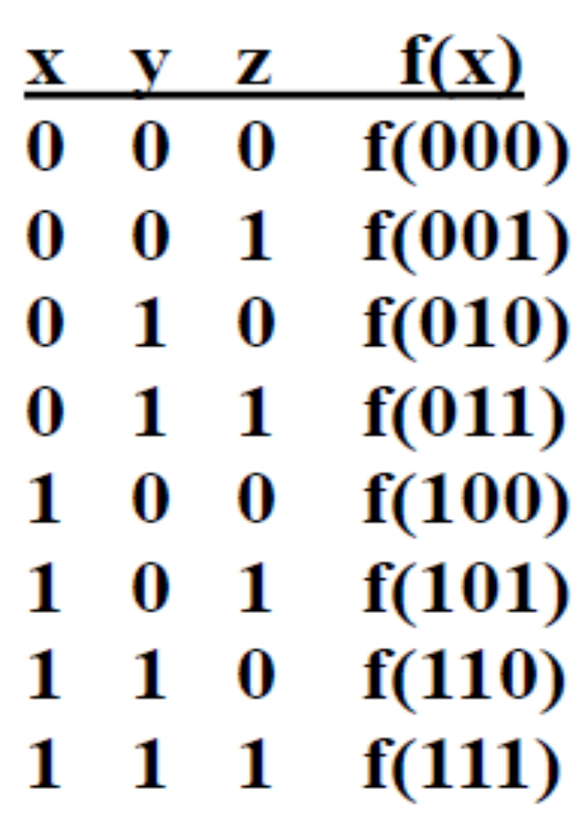
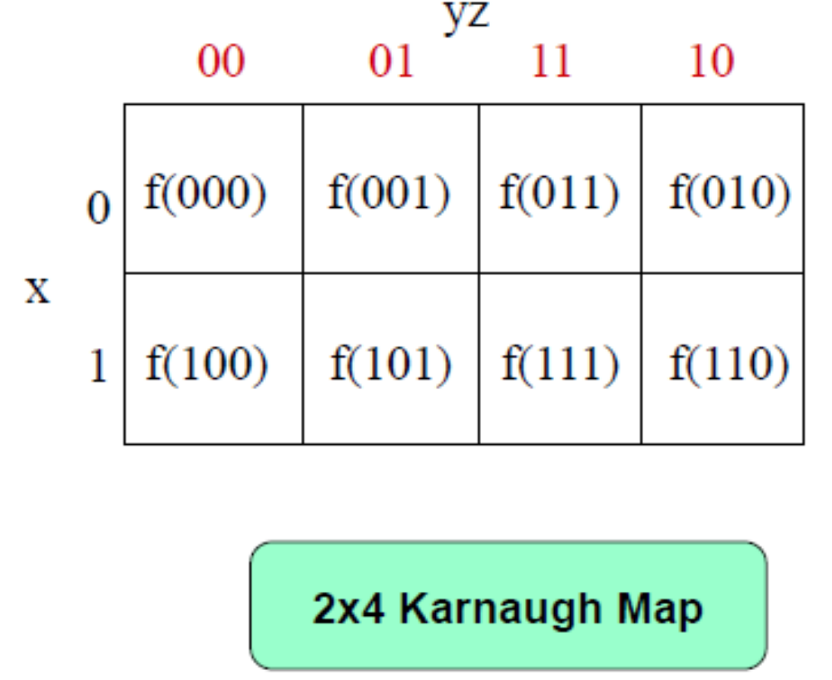
3- Variable K- Map

Slide 18
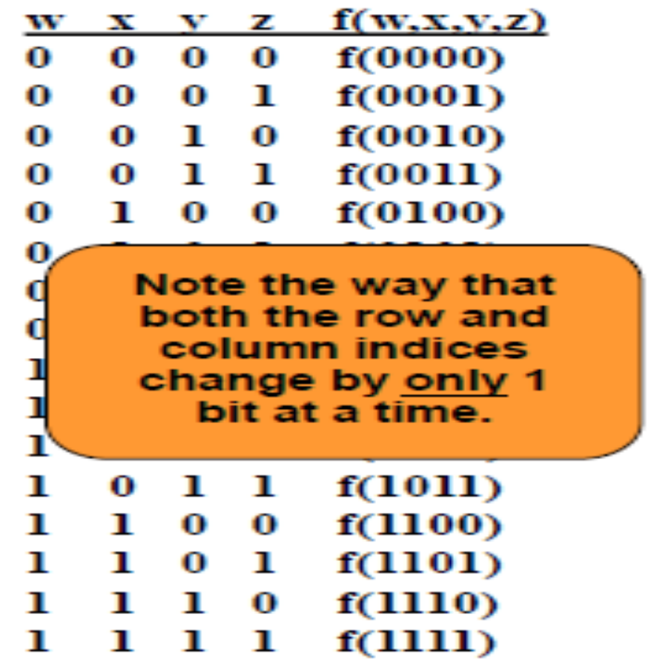
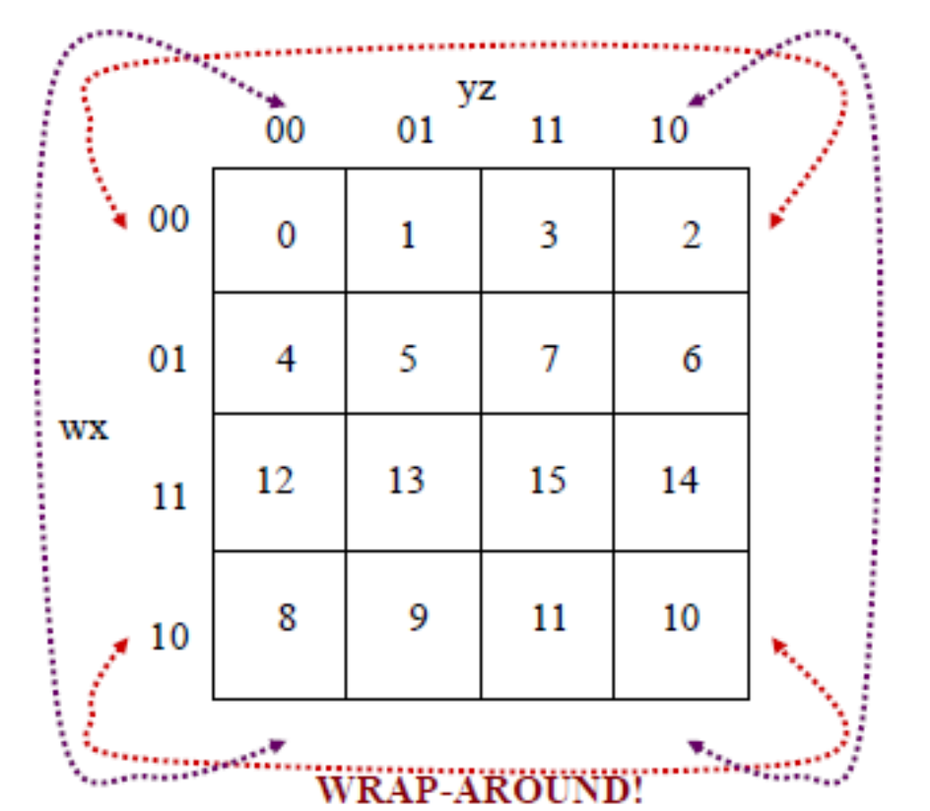
4-Variable K- Map

Slide 19

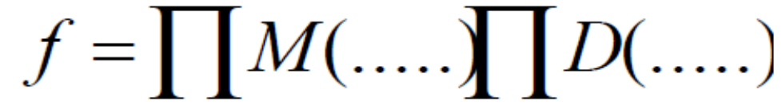
Don’t care conditions
When constructing the terms in the simplification procedure, we can choose to either cover or not cover the don’t care conditions.
To distinguish the don’t care conditions from 1’s and 0’s , an X will be used.
Don’t care conditions are part of function specification. They can be used for both sum-of-product and product-of-sum forms of functions.
Circle the x’s that help get bigger groups of 1’s (or 0’s if POS).

Slide 20
Quine-McCluskey method of minimization
Compute all prime implicants.
Find a minimum expression for Boolean functions.
No visualization of prime implicants.
Can be programmed and implemented in a computer.
Procedure:
Divide all the minterms(and don’t cares) of a function into groups.
Merge minterms from adjacent groups to form a new implicant table.
Repeat step 2 until no more merging is possible.
Put all prime implicants in a cover table (don’t cares excluded).
Identify essential minterms, and hence essential prime implicants.
Add prime implicants to the minimum expression of F until all minterms of Fare covered (Already covered).
Write minimized Boolean equation.

Slide 21
Variable Entered Maps
Due to the difficulty in managing K map exceeding 4 variables like 5 or 6 variables we have the technique called map entered variables[VEM].
As we all know for n variables a K map has 2n variables To allow a smaller map to handle a larger number of variables that is to reduce the number of squares the concept of variable entered mapping was introduced.
This is done by choosing one variable as map entered variable and thus including it in the k map along with the zeros, ones and the don't care conditions.
Procedure:
Make truth table as per Boolean equation.
Make truth table as per variable entered.
Draw the variable entered k-map.
Do the grouping as per rules.
Write minimized Boolean equation.

Slide 22


www.paruluniversity.ac.in

